Slide 1

Coffee Consumption Patterns on Campus
Duru Çamlıkaya
09/01/2025
Introduction to Data Science (DSA 210) 2024 - 2025 Fall Project

Slide 2



Dataset
Hypothesis
Bank account statement including the last 4 months.
The location of the coffee shop where I purchased coffee during the day aligns with the location required by my academic schedule at least 75% of the time.
Google calendar to get information about my schedule.

Slide 3
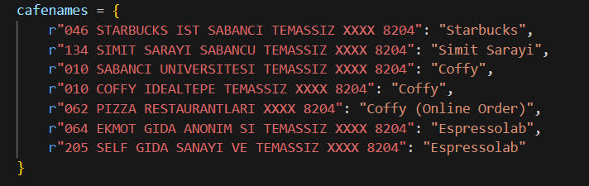
Akbank Dataset
Firstly, the names of the coffee shops on campus in the bank statements were standardized to reflect their actual names.
Fasshane was excluded from the analysis as there were no transactions from this coffee shop within the specified time period.

Slide 4
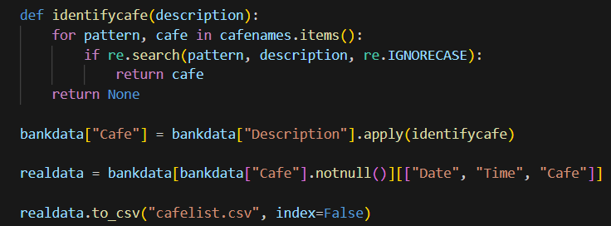
Akbank Dataset
Then I filtered the bank data in date, time and cafe name components.
In the function.
re.search(): Searches for the pattern in the description
If match is found, name ‘cafe’ returns. Otherwise return ‘None’.

Slide 5
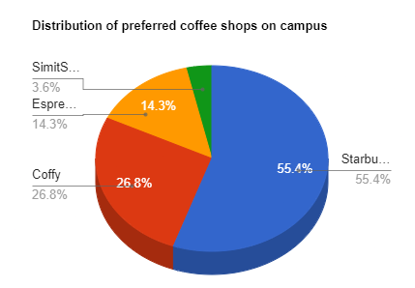
Akbank Dataset
On the side, there is a pie chart created using the data obtained. Based solely on this data, we can see that Starbucks is my most preferred coffee shop on campus.

Slide 6
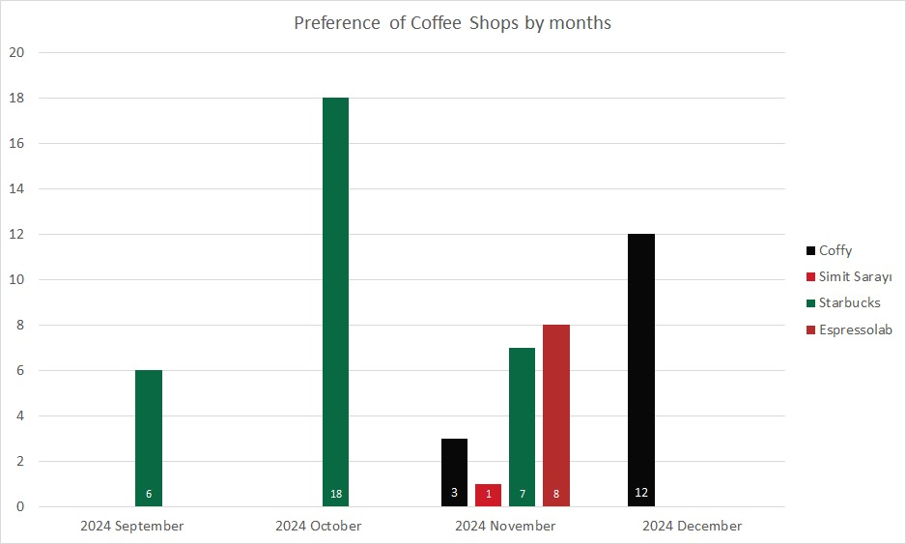
Akbank Dataset
This graph shows the distribution of my coffee shop preferences across the months.

Slide 7
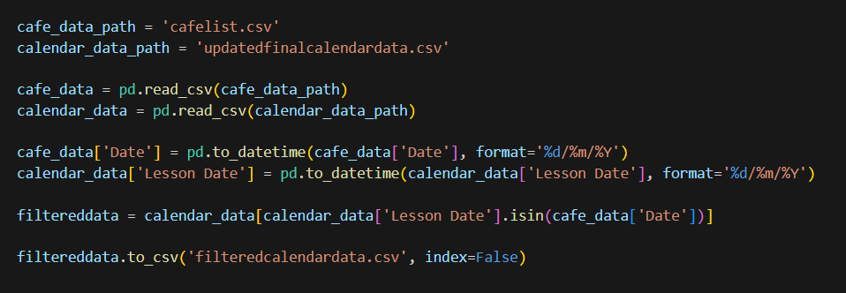
Google Calendar Dataset
I retrieved data from Google Calendar covering the period from September 23 to December 28. From this dataset, I first filtered out entries corresponding only to the days when I purchased coffee.

Slide 8
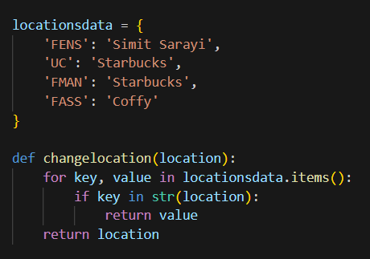
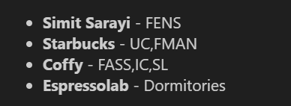
Google Calendar Dataset
Subsequently, I obtained two separate datasets. To establish a connection between them in terms of proximity, I matched each coffee shop with the closest faculty, as shown below.

Slide 9
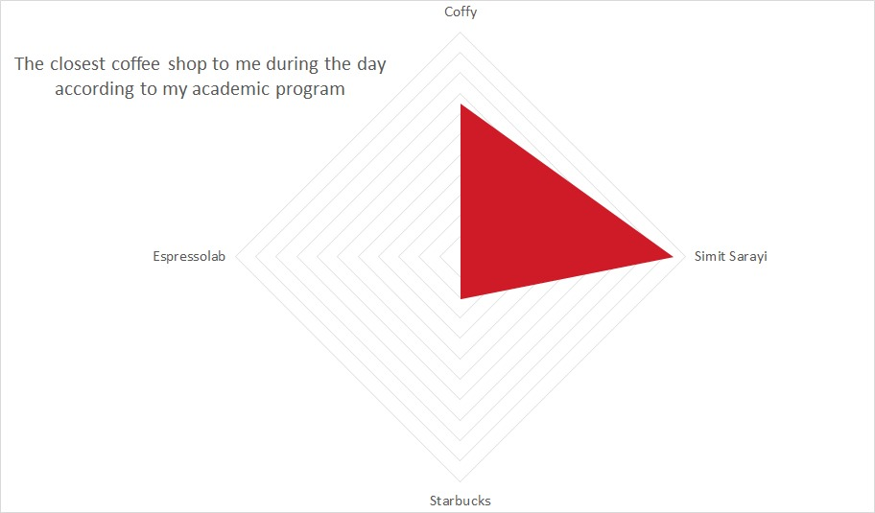
Google Calendar Dataset
This graph indicates that, based on my academic schedule, the closest coffee shop to me is Simit Sarayı.

Slide 10
Conclusion
Graph Setup:
X-axis: Faculties (ordered by proximity, starting from dormitories).
Y-axis: Coffee shops (ordered by proximity to dormitories).
Ideal Alignment: Points on a line with a slope of 1 indicate perfect alignment between coffee purchases and academic schedule.
​
Scoring Methodology:
Scores (0–4) based on proximity to the ideal line:
On the line = 4 points.
1 unit away = 3 points.
2 units away = 2 points.
3 units away = 1 point.
Average score calculated for each faculty:
Average Score = Sum of Scores / Number of Purchases

Slide 11
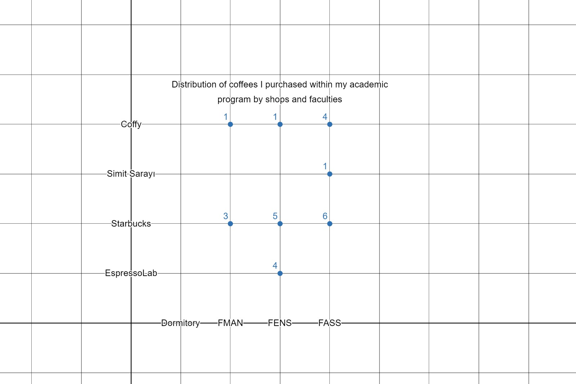
Conclusion
Results:
FMAN: 3.5/4 (87.5%)
FENS: 2.6/4 (65%)
FASS: 2.81/4 (70.45%)
Overall Average: 74.32%
Conclusion:
The overall alignment falls short of the hypothesized value of 75%, indicating the results do not support the hypothesis.

